Slide 1
Smart Snacks
IN SCHOOLS

Slide 2
Webinar Overview
Background
Applicability in New Jersey
Standards for Foods
  General Standards
  Nutrient Standards
  Exemptions
Standards for Beverages
Fundraisers
Recordkeeping
Resources
`

Slide 3
INTERIM FINAL RULE
Healthy, Hunger-Free Kids Act (HHFKA) provided USDA authority to establish minimum nutrition standards for all foods and beverages sold outside of the Federal child nutrition programs in schools
The law specifies that the nutrition standards shall apply to all food and beverages sold:
  Outside the school meal programs
  On the school campus
  At any time during the school day

Slide 4
GOALS OF SMART SNACK REGULATIONS
  Improve diet & health of American children
  Ensure children from all income levels adopt healthful eating habits
  Provide children healthier snack choices at school
  Reduce children’s risk of obesity

Slide 5

SMART SNACK REQUIREMENTS EFFECTIVE DATE
July 1, 2014

Slide 6

SMART SNACKS IN NJ
USDA nutrition standards have replaced NJ Nutrition Policy standards as of July 1, 2014
All local education agencies (LEAs) must follow Smart Snacks standards
NJ Administrative Code and Chapter 45 Public Law are in the process of being updated to be consistent with federal law
LEAs may establish stricter standards in their Local Wellness Policies (LWP)
At a minimum, LWPs should be updated to reflect current Smart Snack Nutrition Standards

Slide 7

WHAT FOOD AND BEVERAGES?
COMPETITIVE FOODS, defined as:
All food & beverages SOLD to students on the school campus during the school day, excluding reimbursable lunch or breakfast meals

Slide 8

WHERE DO THE STANDARDS APPLY?
SCHOOL CAMPUS, defined as:
All areas of the property under the jurisdiction of the school that are accessible to students during the school day

Slide 9


WHEN DO THE STANDARDS APPLY?
SCHOOL DAY, defined as:
The period from the midnight before, to 30 minutes after the end of the official school day
Example
If a school day starts at 9 AM and ends at 3 PM, Smart Snacks rules are in effect from:
through
12 midnight
3:30 PM

Slide 10
APPLIES TO
A la carte foods/beverages sold during the school breakfast and lunch periods and at any time during the school day, including:
Cafeteria
Vending machines
School stores
Fundraisers
Snack Bars

Slide 11
DOES NOT APPLY TO
Treats for birthday parties
Holiday and other celebrations
Foods brought to school in “bagged” lunches
After-school bake sales and fundraisers
Food sold to teachers and staff
Evening or weekend athletic or other school events

Slide 12
FOOD STANDARDS

Slide 13
FOOD STANDARDS
Applies to ALL Grade Levels
An allowable competitive food must meet BOTH:
General Standards
AND
Specific Nutrient Standards
Some exemptions for specific foods allowed

Slide 14
GENERAL STANDARDS
An allowable food item must meet ONE of the following FOUR general standards:
1 – Be a whole grain rich (WGR) product
OR
2 – Have as the first ingredient a fruit, vegetable, dairy product or protein food (meat, beans, poultry, etc.)
OR
3 – Be a “Combination Food” with at least ¼ cup fruit or vegetable
OR
4 - Contain 10% of the Daily Value of one of the following nutrients of public health concern (only until June 30, 2016):
  Calcium, Potassium, Vitamin D, Dietary Fiber

Slide 15

GENERAL STANDARD 1
Whole Grain Rich
Grain products must:
Include 50% or more whole grains by weight or have a whole grain as the first ingredient to be considered WGR
Be consistent with meal pattern standards
Be easily identified by reading product labels

Slide 16
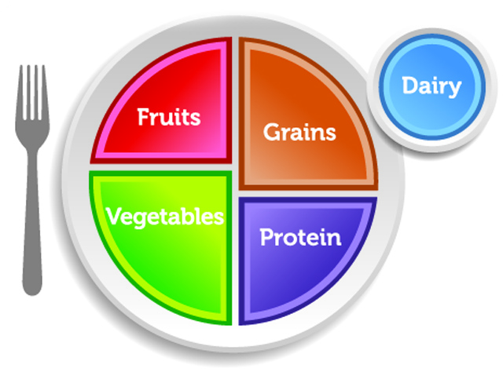
GENERAL STANDARD 2
Major Food Groups
The FIRST ingredient in the product is:
Fruit
or
Vegetable
or
Dairy product
or
Protein food (meat, beans, poultry, etc.)

Slide 17

GENERAL STANDARD 2
Example
If the first ingredient in an ice cream sandwich is milk, does it meet general standards?
Yes, if the first ingredient is milk, it has met General Standard 2 because the first ingredient is a dairy product
However, the ice cream sandwich then needs to meet all nutrient standards in order to be allowable under Smart Snacks

Slide 18
GENERAL STANDARD 3
Combination Foods
Food items containing two or more components from the My Plate food groups:
  Fruit, vegetable, dairy, protein, or grains
  If the combination food does not include a component that meets one of the other 3 general standards, it must include at least ¼ cup of fruit and/or vegetable is required
  Examples
  Hummus & vegetables
  Yogurt and fruit
  Blueberry muffin containing ¼ cup blueberries

Slide 19
GENERAL STANDARD 4:
Nutrients of Public Concern
Foods that contain 10% Daily Value (DV) of ONE of the following nutrients of public concern:
Calcium
Potassium
Vitamin D
Dietary Fiber
Allowable only through June 30, 2016

Slide 20
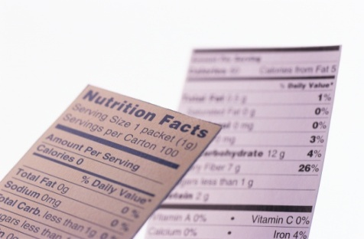
NUTRIENT STANDARDS FOR FOODS

Slide 21
NUTRIENT STANDARDS
After meeting one of the general standards, food items must next meet ALL SIX of the following nutrient standards:
Total Fat
Saturated Fat
Trans Fat
Sodium
Calories
Total Sugar

Slide 22
TOTAL FAT STANDARD
≤ 35% of total calories from fat per item as packaged/served
Exemptions include:
  Reduced Fat Cheese
  Part-Skim Mozzarella Cheese
  Nuts, Seeds & Nut/Seed Butters
  Dried Fruit w/Nuts and/or Seeds (No Added Nutritive Sweeteners or Fat)
  Seafood (No Added Fat)

Slide 23
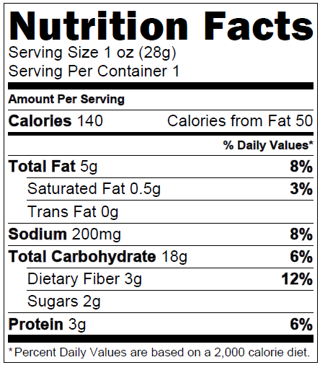
CALCULATING TOTAL FAT PERCENTAGE
There are 2 acceptable methods for calculating total fat %
  Method 1:
  Calories from fat x 100
  Total calories
Example
50 / 140 = 0.3571
0.3571 x 100 = 35.7%
Must be: ≤35%
Do not round
This product is not allowed

Slide 24
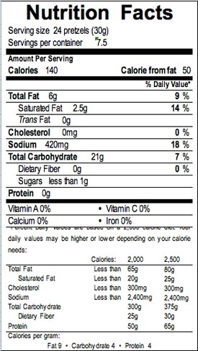
Calculating Total Fat Percentage
Method 2
  Total fat gms x 9 cal/gm x 100
  Total calories
Example
5 x 9 cal/gm =45 calories
45 / 140 =0.3214
0.3214 x 100 = 32.14%
Must be: ≤35%
This product is allowed
WHAT? It’s the same product!

Slide 25
CALCULATING TOTAL FAT PERCENTAGE
NOTES
Each method may yield slightly different results
It is acceptable to use only one method
Do not round results for either method
If either method results in ≤35% calories from fat, the product WILL MEET the total fat standard

Slide 26

Trans Fat
Saturated Fat
<10% of total calories per
item as packaged/served
Exemptions:
  Reduced Fat Cheese
  Part-Skim Mozzarella
  Nuts, Seeds & Nut/Seed
  Butters
  Dried Fruit w/ Nuts and/or Seeds (No Added Nutritive Sweeteners or Fat)
Zero grams per portion as packaged/served (< 0.5 g)

Slide 27
CALCULATING SATURATED FAT PERCENTAGE
  Saturated fat gm x 9 cal/gm x 100
  Total calories
Example
0.5g x 9 cal/gm =4.5 calories
4.5 / 140 =0.3214
0.3214 x 100 = 3.21%
Must be: <10%
This product meets saturated fat
standard

Slide 28
SODIUM STANDARDS
  Entrées: ≤ 480 mg sodium per item (unless exempted)
  Snack & Side Items:
  ≤ 230 mg (until June 30, 2016)
  ≤ 200 mg (after July 1, 2016)

Slide 29
CALORIE STANDARDS
  Entrees: ≤ 350 calories (unless exempted)
  Snack Items/Side Dishes:
  ≤ 200 calories per item

Slide 30
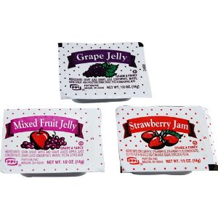
ACCOMPANIMENTS
Must be included in the nutrient profile as a part of item served
  Examples include:
Salad dressings
Butter or jelly
Cream cheese
Catsup or mustard
Garnishes
No pre-portioning required
  An average portion may be determined

Slide 31
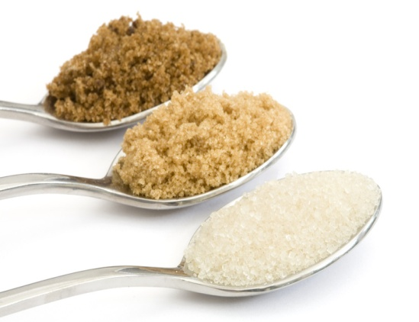
TOTAL SUGAR STANDARDS
≤ 35% of weight from total sugars per item as packaged/served

Slide 32
SUGAR EXEMPTIONS
Dried/Dehydrated Fruits or Vegetables (No added nutritive sweeteners)
Dried Fruits with nutritive sweeteners for processing and/or palatability (e.g., dried cranberries, tart cherries, and blueberries)
Dried Fruit with only Nuts/Seeds (No added nutritive sweeteners or fat)

Slide 33
Total Sugar Calculation
To calculate percentage of sugar by weight:
Total sugar gms x 100
Total product weight in gms
Example
2g / 28g = 0.0714
0.0714 x 100 = 7.14%
Weight of all sugars is ≤35%
of the serving size weight
This product meets sugar criteria criteria.

Slide 34

GENERAL & NUTRITION STANDARDS SUMMARY
“All Foods Sold in Schools” must:
• Be a “whole grain-rich” grain product; or
• Have as the first ingredient a fruit, a vegetable, a dairy product, or a protein food; or
• Be a combination food that contains at least ¼ cup of fruit and/or vegetable; or
• Contain 10% of the Daily Value (DV) of one of the nutrients of public health concern, calcium, potassium, vitamin D, or dietary fiber (will expire 2016).
Calorie limits:
° Snack items: ≤ 200 calories
° Entrée items: ≤ 350 calories
Sodium limits:
° Snack items: ≤ 230 mg (200 mg in 2016)
° Entrée items: ≤ 480 mg
Fat limits:
° Total fat: ≤ 35% of calories
° Saturated fat: < 10% of calories
° Trans fat: zero grams
Sugar limit:
° ≤ 35% of weight from total sugars in foods
DON’T FORGET
ITEMS

Slide 35

THE EASY METHOD
USE THE SMART SNACKS CALCULATOR TO DETERMINE IF FOODS ARE COMPLIANT
Link to calculator available under Resources in SNEARS

Slide 36
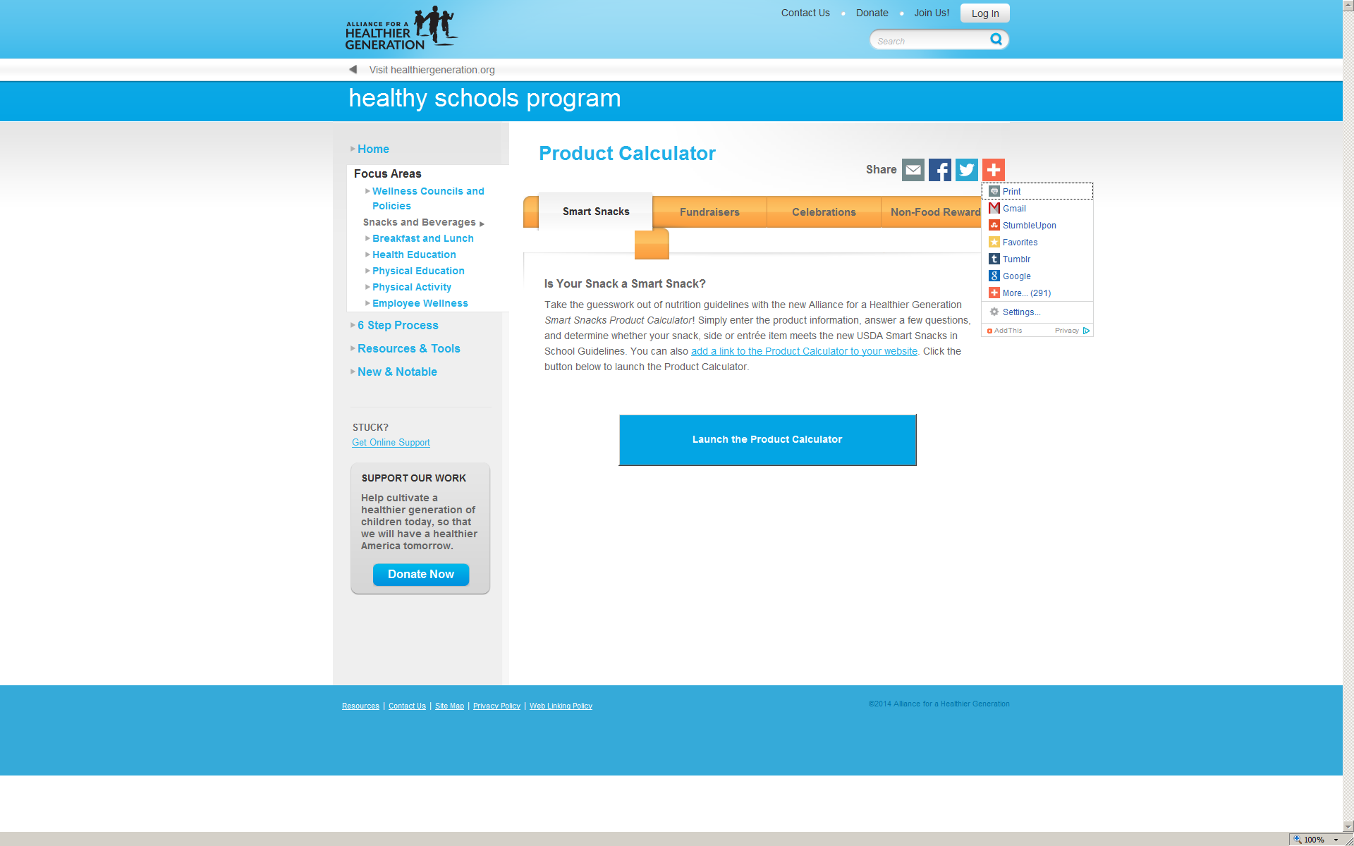
ALLIANCE FOR A HEALTHIER GENERATION
SMART SNACKS CALCULATOR
https://schools.healthiergeneration.org/focus_areas/snacks_and_beverages/smart_snacks/product_calculator/

Slide 37
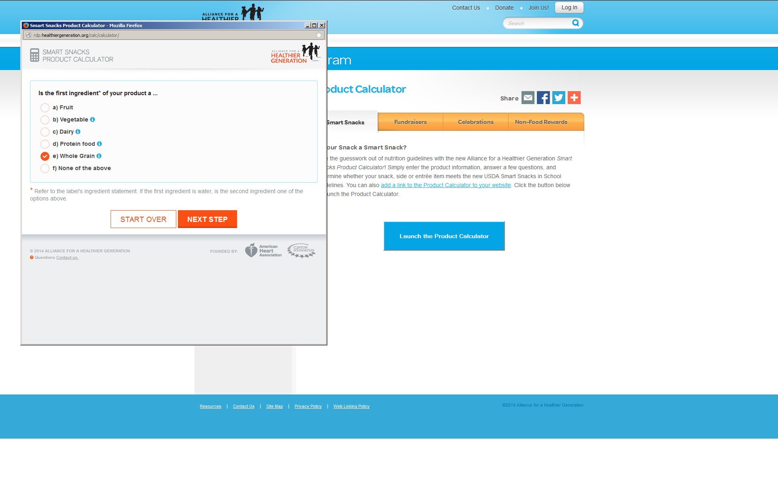
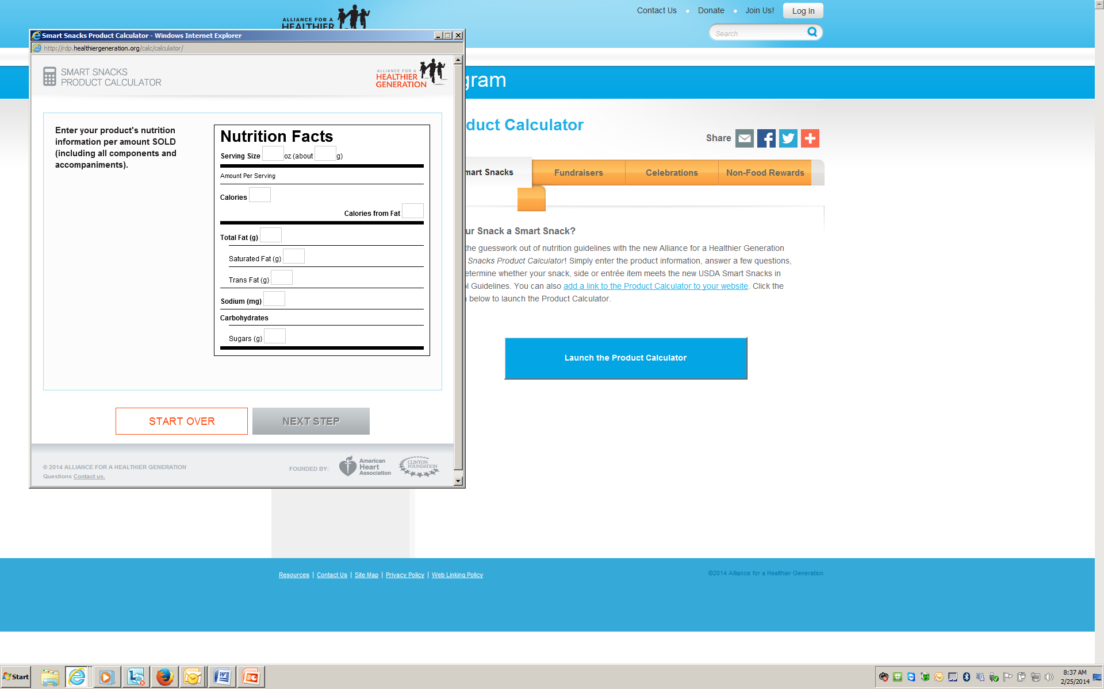
SMART SNACKS CALCULATOR
“Simply answer a few questions, enter the product information, and determine whether your beverage, snack, side or entrée (not exempted) item meets the new USDA Smart Snacks in School Guidelines.
Then save and print for your records!”

Slide 38
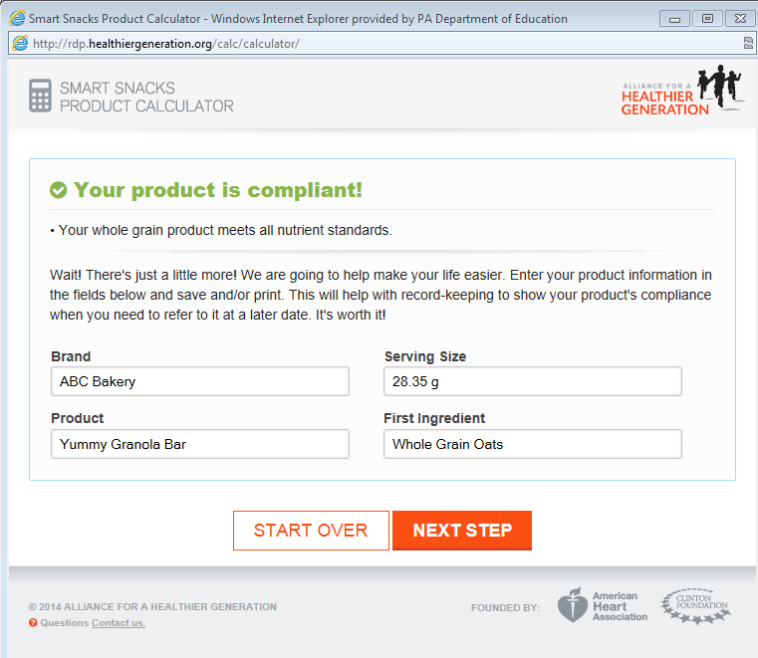

Slide 39
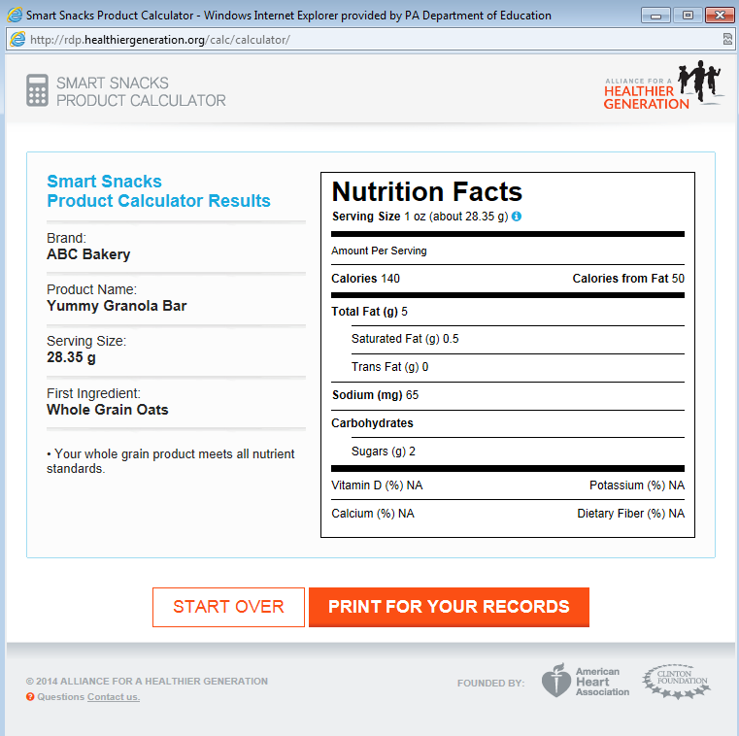

Slide 40
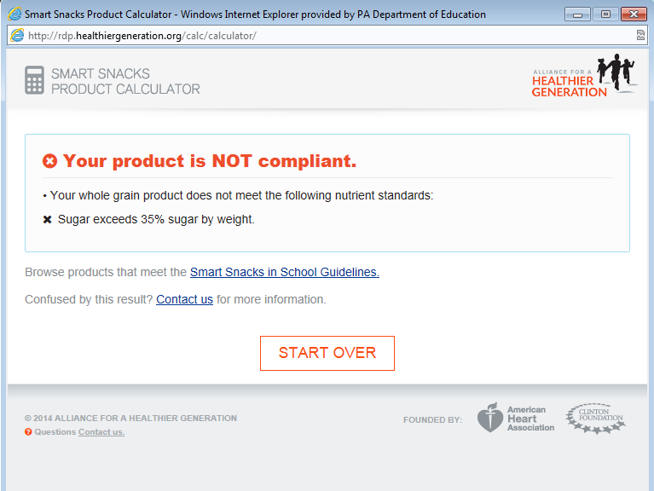

Slide 41
Exemptions from Nutrition Standards

Slide 42

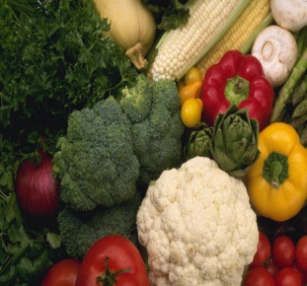
EXEMPTIONS FROM ALL NUTRIENT
STANDARDS
Fruit
Fresh
Frozen
Canned:
  In water
  In 100% juice
  In light syrup
  In extra light syrup
Vegetables
Fresh
Frozen
Canned:
  No added ingredients except water
  Small amount of sugar for processing purposes is allowed

Slide 43
ENTRÉE EXEMPTIONS
ENTRÉE ITEMS ONLY
Entrée exemption is for day served as part of the reimbursable meal and the next school day
Portion sizes for exempted entrees sold a la carte must be the same as the reimbursable meal portion
Side dishes sold a la carte as competitive food must meet Smart Snack standards at all times

Slide 44
DEFINITION OF ENTRÉE
  Combination food of meat/meat alternate & whole grain rich food
  OR
  Combination food of vegetable or fruit & meat/meat alternate
  OR
  Meat/meat alternate alone, with the exception of yogurt, low-fat or reduced fat cheese, nuts, seeds and nut or seed butters and meat snacks (such as dried beef jerky and meat sticks)

Slide 45

DEFINITION OF ENTRÉE
NEW!!
  SCHOOL BREAKFAST PROGRAM ENTREES
  LEA can determine entrée items
  served at breakfast (May be grains only)
  Examples:
  WGR Pancakes
  WGR Bagel w/ Cream Cheese
  Breakfast Sandwich w/ Egg & Cheese

Slide 46
ENTRÉE EXEMPTION NOTES
If a school does not participate in the School Breakfast Program:
  Grain-only items sold a la carte, along with their accompaniments, must meet all standards prescribed for side dishes/snack items
Exempted breakfast entrees (including grain only entrees) can also be offered for a la carte sale on the day of service and next school day for lunch (and vice versa)

Slide 47
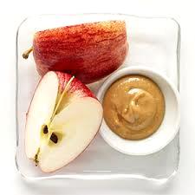
PAIRED FOODS EXEMPTION
BRAND NEW!!
Paired Foods are:
Items that individually have been exempted from one or more nutrient standards (fat, saturated fat and/or sugar) and retain their exemption when packaged and sold together
Must still meet Calorie & Sodium Standards
Examples:
Peanut Butter & Celery
Peanut Butter/Celery/Raisins
Reduced Fat Cheese & Apples
Peanuts & Apples

Slide 48
Nutrition Standards for Beverages

Slide 49
STANDARDS FOR BEVERAGES
  Vary by Grade Level
  Additional options available ONLY at the high school level (grades 9 -12)
  Specific Types of Beverages Allowed
  Specific Container Sizes Allowed
Note: If middle school grades are mixed with high school grades in one building (e.g. grades 7-9, 7-12, etc.), the middle school beverage standards must be followed for ALL grades

Slide 50
NO “TIME AND PLACE” RESTRICTION
No restriction on the sale of any allowable beverage at any grade level, during the school day, anywhere on the school campus

Slide 51
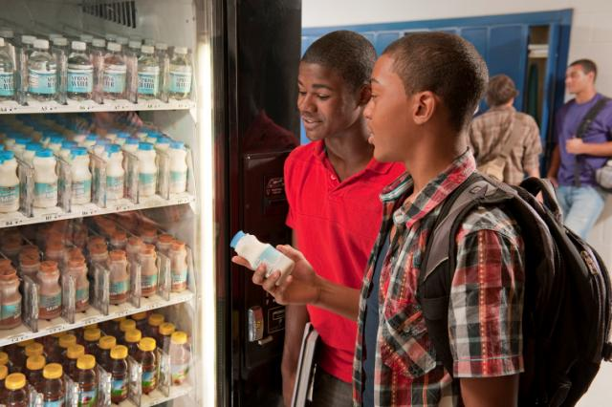
BEVERAGES ALLOWED FOR ALL GRADES
Water
Milk
Juice

Slide 52

BEVERAGES FOR ALL: WATER
Plain Water (Nothing Added), Carbonated or Noncarbonated
No Size Limit

Slide 53
BEVERAGES FOR ALL: MILK
Unflavored fat free and 1% milk
Flavored fat free milk
Maximum Serving Sizes:
  8 fluid ounces - Elementary
  12 fluid ounces - Middle & High

Slide 54
BEVERAGES FOR ALL: JUICE
100% Fruit and/or Vegetable Juice
100% Juice diluted with water (carbonated or noncarbonated) – no added sweeteners
Maximum Serving Sizes:
  8 fluid ounces - Elementary
  12 fluid ounces - Middle & High

Slide 55
OTHER ALLOWABLE BEVERAGES
IN HIGH SCHOOL
Calorie-Free Beverages:
  Maximum Serving Size: 20 fluid ounces
  Calorie-free flavored water, with or without carbonation
  Other “calorie-free” beverages with less than 5 calories per 8 fluid ounces, or up to 10 calories per 20 fluid ounces
Notes:
Other calorie free beverages with
<5 calories per 8 fluid ounces or;
<10 calories per 20 fluid ounces.

Slide 56
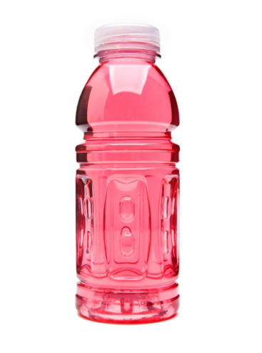
OTHER ALLOWABLE BEVERAGES
IN HIGH SCHOOL
Lower-Calorie Beverages
Maximum Serving Size: 12 fluid ounces
Up to 60 calories per 12 fluid ounces
or
Up to 40 calories per 8 fluid ounces
“Sports drink”

Slide 57


CAFFEINE
Elementary and Middle School:
  Foods and beverages must be caffeine-free, with the exception of trace amounts of naturally-occurring caffeine substances (e.g. chocolate milk)
High School:
  No caffeine restrictions

Slide 58
Beverages (Effective 7-1-2014)
Beverage | Elementary | Middle | High
Plain Water w/ or w/out carbonation | No size limit | No size limit | No size limit
1% Low-Fat Milk, unflavored* | ≤ 8 oz | ≤ 12 oz | ≤ 12 oz
Nonfat Milk, unflavored or flavored * | ≤ 8 oz | ≤ 12 oz | ≤ 12 oz
100% Fruit/Vegetable Juice** | ≤ 8 oz | ≤ 12 oz | ≤ 12 oz
Calorie Free Beverages (Calorie –Free Flavored Water w/ or w/out carbonation & Other Calorie Free Beverages) | ----- | ----- | Maximum Size 20 oz < 5 Calories/8 oz ≤ 10 Calories/20 oz
Lower Calorie Beverages | ----- | ----- | Maximum Size 12 oz ≤ 40 Calories/8 oz ≤ 60 Calories/12 oz
Caffeine | Food & Beverages --- No Caffeine | Food & Beverages --- No Caffeine | No Restrictions
*Includes nutritionally equivalent milk alternatives, as permitted by NSLP/SBP
**May include 100% juice diluted with water (w/ or w/out carbonation) & with no added sweeteners.

Slide 59

FUNDRAISERS

Slide 60
WHAT IS A FUNDRAISER?
USDA considers a fundraiser as an event during which currency/tokens/tickets are exchanged for the sale/purchase of a product in support of the school or school related activity, including:
Giving away a food, but suggesting a donation
A vending machine where the profits are used to support a school-sponsored club or activity
Money collected ahead of time and food distributed during the school day

Slide 61
SO WHAT ABOUT FUNDRAISERS?
All foods and beverages that meet the Smart Snacks standards may be sold at fundraisers on the school campus during the school day (except meal periods as required in NJ Administrative Code)
Smart Snacks standards do not apply to items sold during non-school hours, weekends, or off-campus fundraising events

Slide 62
FUNDRAISERS IN NJ SCHOOLS
NO FUNDRAISER EXEMPTIONS ALLOWED
Therefore, all fundraisers selling food and beverages anywhere on school campus during the school day must meet Smart Snacks requirements
Note: As per NJ Administrative Code, all income from the sale of food or beverages during breakfast and lunch meal periods, (even if they meet smart snack standards) must accrue to the food service program

Slide 63
FUNDRAISERS
Vending Machines
Fundraiser vending machines on school grounds during the school day that are operational must meet Smart Snacks requirements
Reminders
Fundraiser vending machines cannot operate at all during meal periods if income is not going to food service program
Smart Snacks standards do not apply 30 minutes after the end of the school day (until 12 AM midnight if the following day is a school day)

Slide 64
ALLOWABLE FUNDRAISERS
Food and beverages meeting Smart Snack standards may be sold at fundraisers on school campus during school hours (except meal periods)
Non-food fundraisers may be held at anytime
Food and beverage items sold during non-school hours, weekends, off-campus fundraising events or concessions during after-school sporting events, school plays, etc.

Slide 65
MORE ALLOWABLE FUNDRAISERS
Food sold that is clearly not for consumption at school For example:
Scout cookie orders
Frozen pizza sales, cookie dough, etc. that must be prepared and served at home
Since order forms are simply handed out in school and/or the food is delivered to the students at school to take home, these are not considered competitive food fundraisers

Slide 66
CULINARY CLASSES
Some culinary education programs sell foods to students during the school day
  Must comply with the Smart Snacks nutrition standards
Suggested Revenue Alternatives:
  (More) services for adults
  Sell off campus
  Catering for school events
  Prepare more foods that meet the Smart Snacks standards

Slide 67

RECORDKEEPING
Records documenting compliance with Smart Snacks must be maintained by those designated as responsible for any competitive food service in the school
School Foodservice maintains records for competitive foods sold under the nonprofit school food service account
Schools/Districts maintain records for all other competitive food sales (e.g. vending machines, school stores, etc.)
Records include, but are not limited to receipts, nutrition facts labels, product specifications, printouts from Smart Snack Calculator. Menus, production records or other documentation can be used to document allowable entrée exemptions

Slide 68
MONITORING & COMPLIANCE
The State Agency will monitor compliance as part of the administrative review (AR)
Sales of foods and beverages in all locations, including vending machines, school stores, snack bars and other food or beverage points of sale available to students will be monitored through a review of records
If violations occur --- technical assistance and corrective action plans will be required. No fiscal action currently taken

Slide 69
RESOURCES
SNEARS:
Click on Resources Tab
USDA Smart Snacks Memos/Q&As posted under “USDA Memos”
Link to Smart Snacks Calculator posted under “Smart Snacks”
Direct Link to Smart Snacks Calculator:
https://schools.healthiergeneration.org/focus_areas/snacks_and_beverages/smart_snacks/product_calculator/
OR
http://tinyurl.com/lohcz6w
Additional Smart Snacks Info:
  http://www.fns.usda.gov/school-meals/smart-snacks-school

Slide 70

Questions

Slide 71
THANK YOU FOR ATTENDING
For questions:
Contact Us at 609-984-0692
For recorded webinar:
Click on the training tab in SNEARS
For webinar power point presentation
Click on the Resources tab in SNEARS
Click on Presentations on left side

